Slide 1

Do Masks Really Reduce the Spread of COVID-19?
A Panel Data Analysis
Team Disinfectant Wipes
Notes:
Hi everyone, we are team Disinfectant Wipes. We have Jing, Boya, Jiangfan, and Stella on our team.
Our analysis project is trying to explore one question: Do masks really help reduce the COVID-19 spread?

Slide 2




Roadmap
Objective
Data Source
Model Building
Recommendation
Notes:
We are going to present our project in the following four main aspects: what’s the objectives, where we got our data, why do we need our model, and what we would recommend for actions.

Slide 3
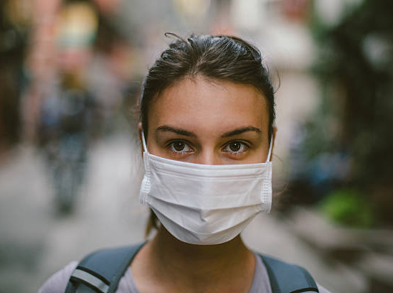
Background
Face masks: should we have been wearing them right from the start?
Notes:
At the beginning of the coronavirus outbreak, people in East Asian countries wore masks to prevent the spread. Meanwhile, people in the US didn’t think it was necessary for everyone to wear masks as CDC did not advise to do so. It was not until recently that the US officials started to suggest people to wear face coverings.
Why was there a shift in official advice? And most importantly, how effective are masks, or the awareness of wearing face masks, in stop spreading the novel coronavirus? These are the questions we want to solve.

Slide 4

Objectives: Explore and Quantify
Explore the correlation between mask interest and positive case increase
Quantify the effect of the awareness of wearing masks
Notes:
So we framed the problem into an analytical one. We’d like to use data analysis to explore the correlation between mask search interest and increase in the number of positive cases, and measure the effect of the awareness of wearing a mask against COVID-19.

Slide 5



Data Source
Search Interests
COVID-19 Case Tracking
Shelter-in-Place Order
Proxy for people’s interest in masks, hand sanitizer, panic buying
Number of people tested, tested positive, hospitalized, dead, etc.
The effective date of shelter-in-place orders in each state
Notes:
To answer those questions, we collected data mainly from those three sources.
Google Trends
https://trends.google.com/trends/?geo=US
Google trends provides data on people’s search interests on different topics. We collected the search volume and trend of “mask” as a proxy of people’s interest or awareness of wearing a mask.
COVID-19 Case Tracking
https://covidtracking.com/data
Of course, we need data for the virus. We collected case tracking data in the US from the second data source.
Shelter-in-place Order
https://observablehq.com/@mbostock/a-timeline-of-shelter-in-place
In addition, we gathered the start date of shelter-in-place orders for each state, if there is any.

Slide 6
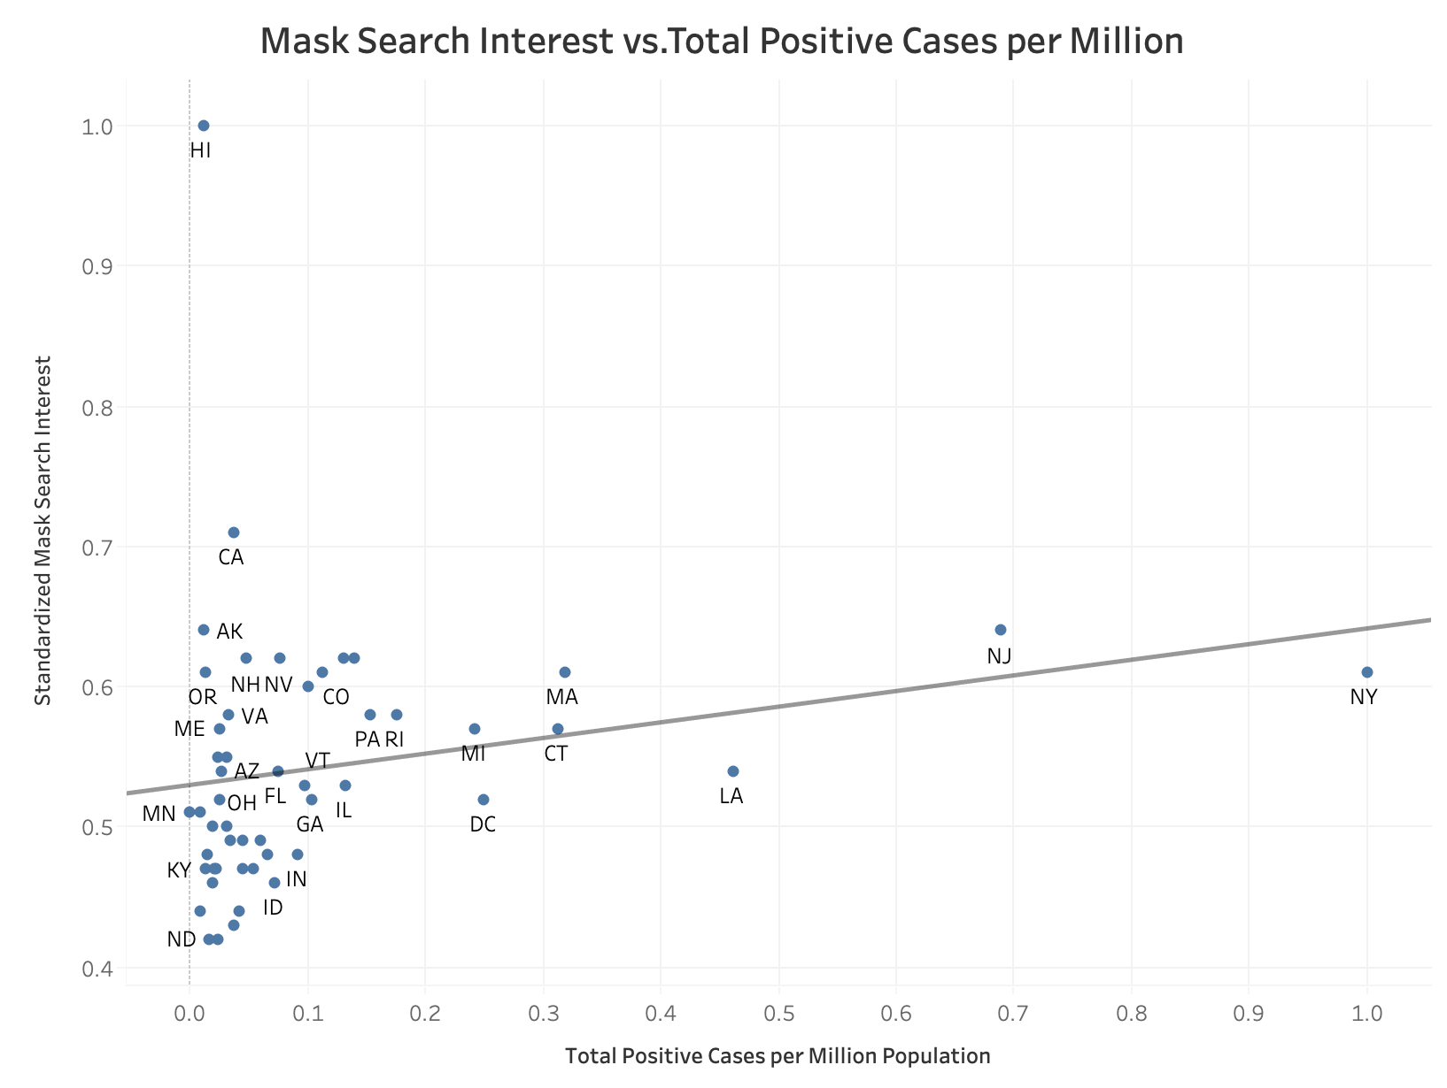
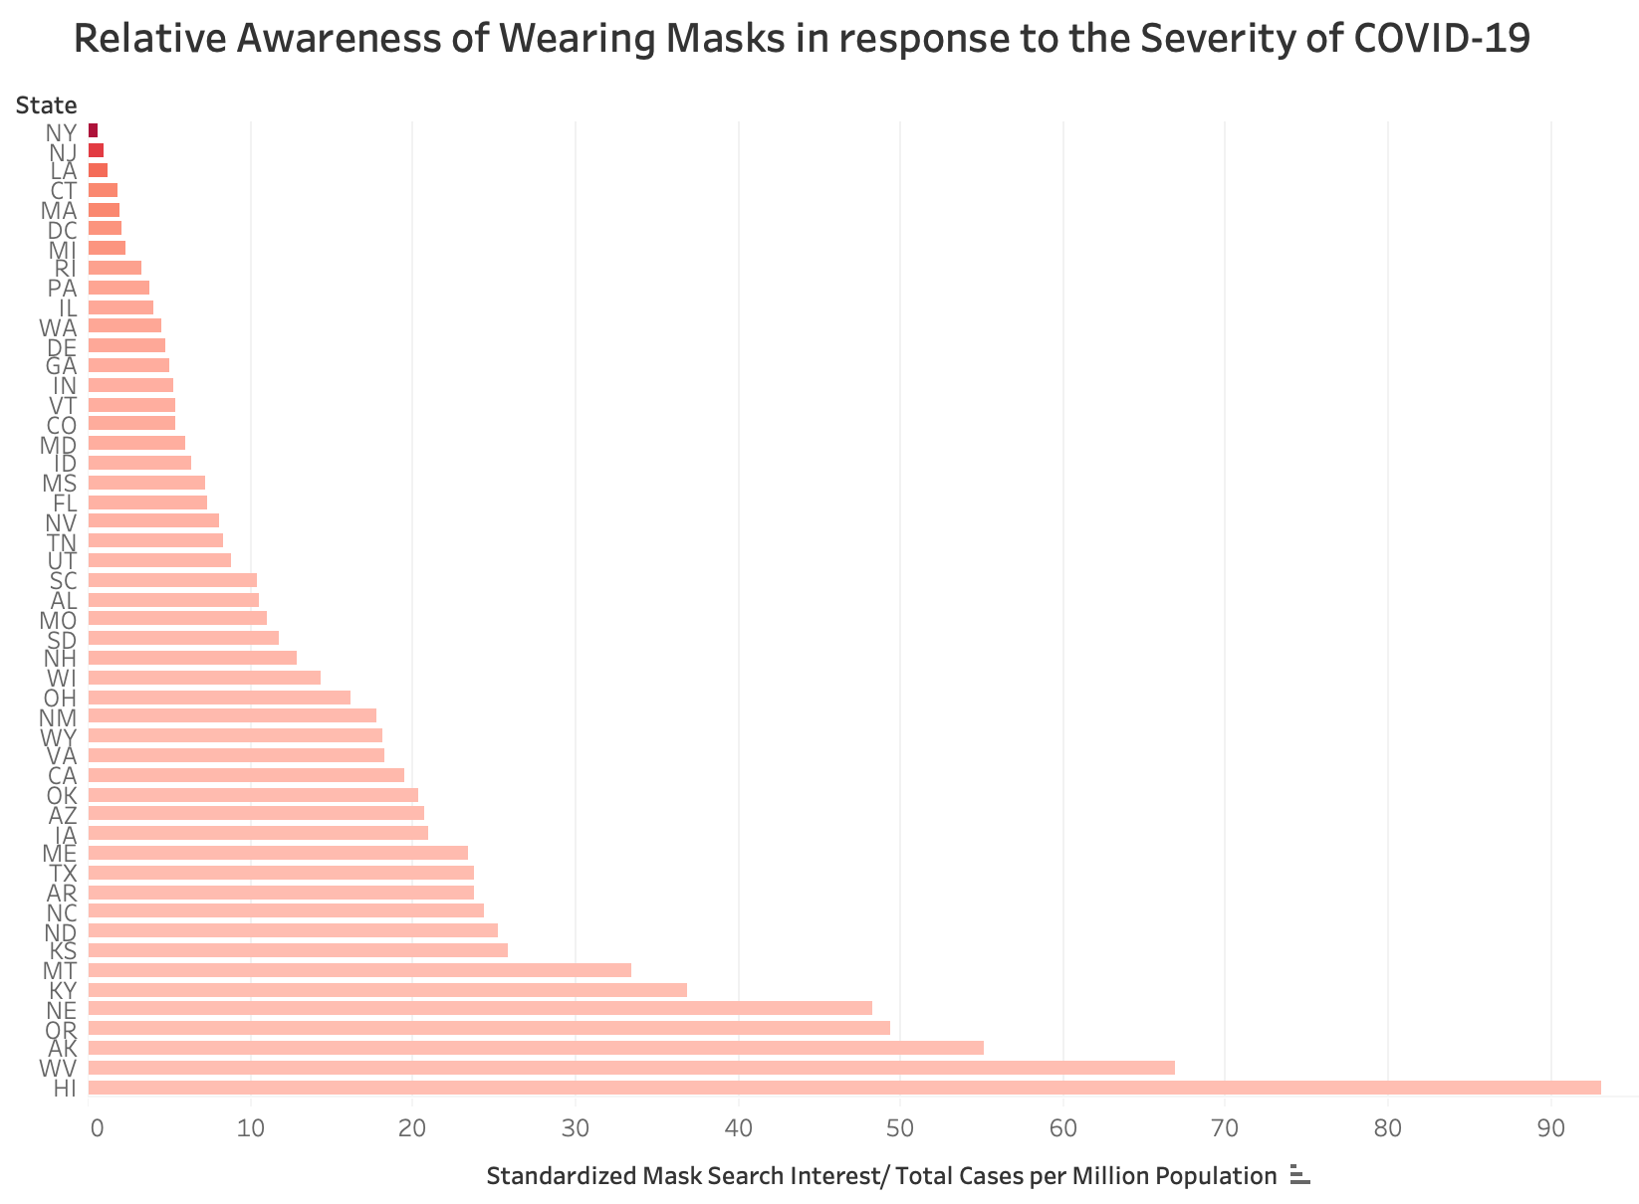
What is the True Relationship between Interest in Masks and the Number of Cases?
Mask Search Interest
Relative Awareness =
Total Positive Cases per Million
Notes:
Now, let’s look at the preliminary analysis of the data. The first graph shows a positive relationship between the mask search interest and the confirmed case per capita. It seems that the state has more serious situations would have more search interest in masks.
However, we design a metric called the relative awareness shown in the second graph. We found the situation is quite different. For the states have serious situations (for example, the New York state), the ratio of the relative awareness is significantly smaller than other states. It seems that they are lack of mask search interest.
So...Which picture tells the true story. (next slides)
With those data in hand, let’s look at people’s interest in masks against the number of confirmed cases in each state. In the first plot, we fitted a regression line between those two variables, and it shows there is a positive relationship between interest in masks and the total number of cases per million population. This may mean that the more serious the situation is in a state, the more interested people are in searching, or more aware of wearing, masks.
However, in the second plot, when we divide the search interest in masks by the number of positive cases per million population in each state, we found the situation is quite different among different states. For some states with very serious situations (NY, NJ), the ratio of search interest for masks to number of cases is significantly smaller than other states. We may infer that the lack of awareness of wearing masks could be correlated to more positive cases in these states.
Then...Which picture shows the real case?
Notes:
Mask Search Increase: Average search interest for the last 90 days
Left plot:
State level aggregate
Each data point represent one state, averaged across the whole time range (standardized between 0 and 1)

Slide 7
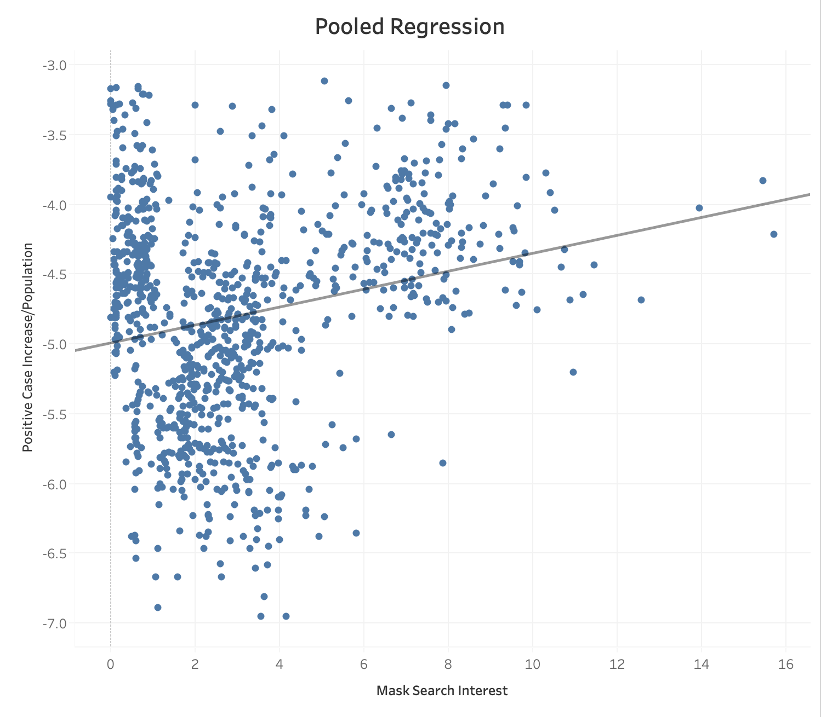
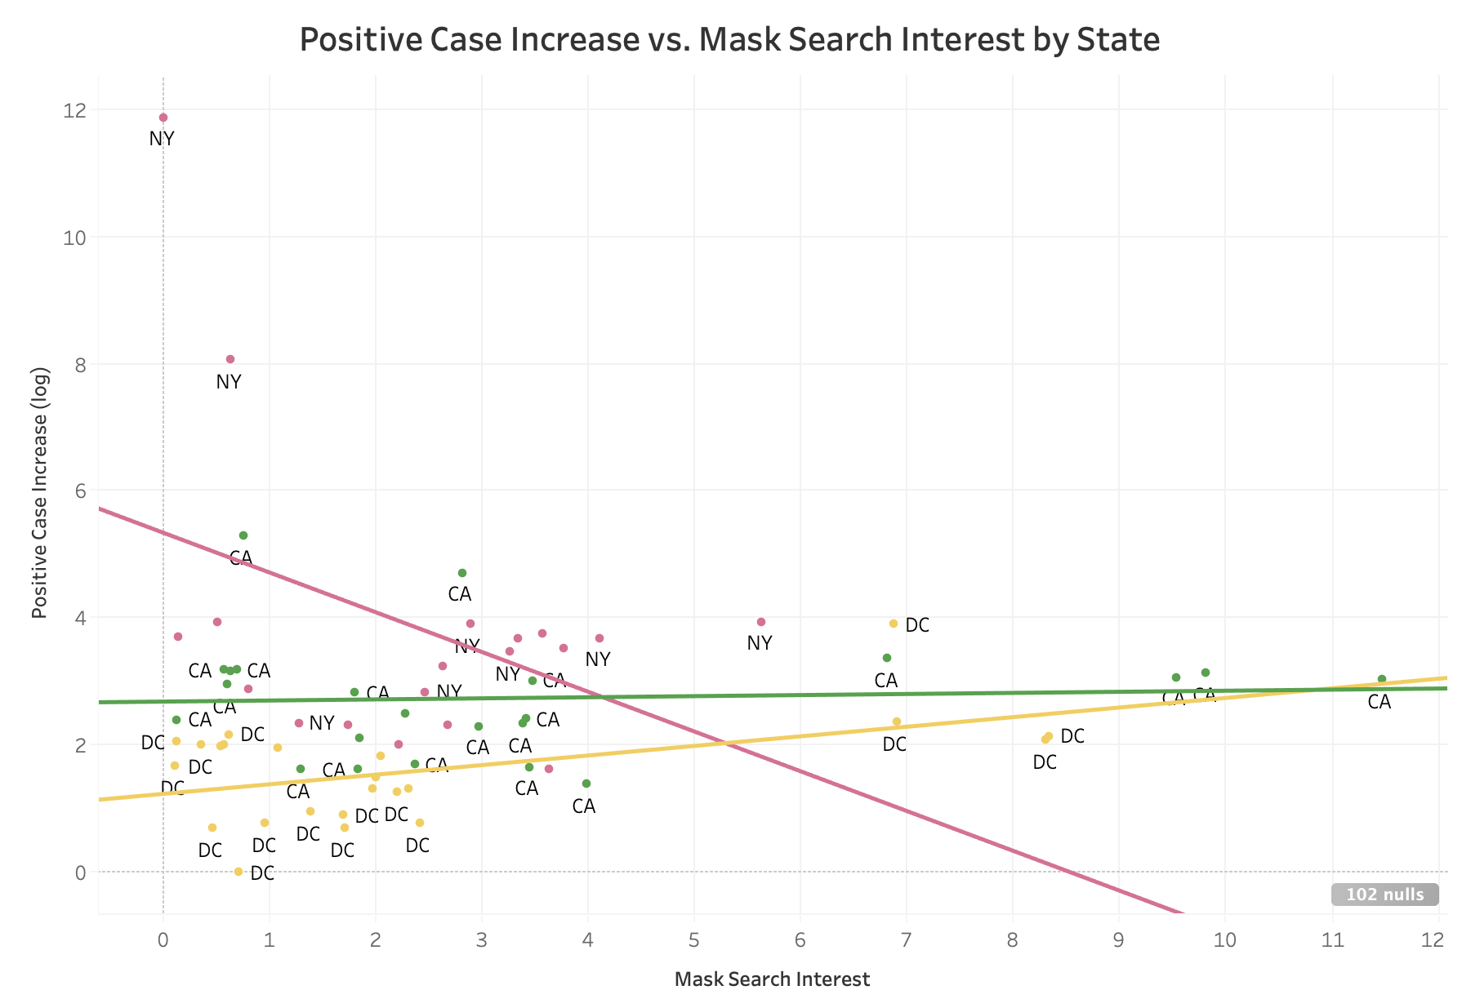
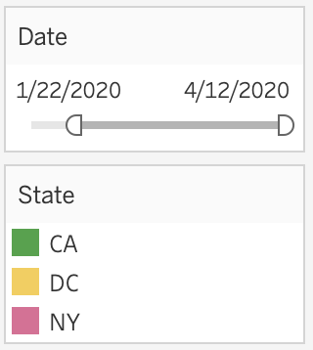
Why Do We Need A Fixed Effect Model (FEM)?
Pooled regression across all states:
Only one aggregated regression line
State characteristics affect the # of positive cases
Our Method: Fixed state effect regression on panel data of all states:
Controls time-invariant state-specific characteristics
Considers a 14-day lag effect
Log(confirmed case per capita)= 0.064 * Mask interest - 4.99
P-value < 0.0001
Notes:
To begin with, we run a pooled regression to detect how mask interest affected the confirmed rate. In the first graph, it shows an overall positive relationship. However, if we run the regression state by state, different states may have different relationships. Some states showed positive ones while others showed negative.
So, in order to draw more reliable conclusions, we will use panel regression to control the time-invariant, state-specific attributes. (end)
So, we built a fixed effects model on the panel data to measure the effect of search interest of “mask” on the number of positive cases increased.
A pooled regression of all states will give different result from their individual regressions, because the effect of state characteristics (state demographics, economics, politics, etc) on independent variable is not disentangled (see left). So, we use panel regression to control for time-invariant unobserved state characteristics and take into consideration of 14-day lag effect of search interest on the number of positive cases.

Slide 8




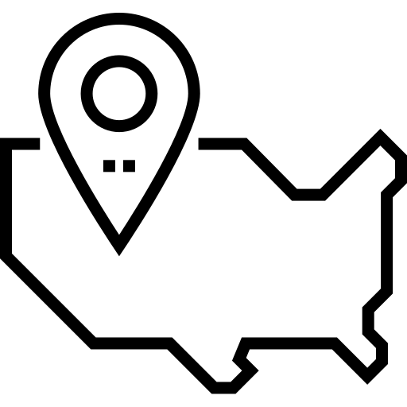





What Went into Our Model?
Dependent Variable:
Increase in Confirmed Cases of COVID-19
Independent Variables:
Google Trends
(Search Interest)
#Mask
#Hand Sanitizer
#Toilet Paper
#Coronavirus
Order
Whether a stay-at-home order is in place
Medical Resources Available
# of Hospital Beds
# of ICU Beds
# of Seniors
Time span:
03/01 - 04/12
Regions:
All states in the US
Dimension:
1064 * 29
Notes:
To build our model, first, we need to consider that what could be the factors associated with the increase in confirmed COVID-19 cases. As mentioned earlier, we collected data on case tracking, google trends, and shelter-in-place orders. The data from google trends is a proxy on people’s awareness of matters related to COVID-19. The stay-at-home order acts as a measure of government policies. Since it takes time for the effect of the awareness and stay-at-home orders to be observable in the increase in confirmed cases, we added a 15-day lag to those variables. We also considered the level of abundance in medical resources and age structure in different states, but they turned out not selected by our final model.
Data on Medical Resource: available from https://data.world/liz-friedman/hospital-capacity-data-from-hghi

Slide 9
FEM Results:
Being Aware of Wearing Masks Helps!
 | Parameter | Std. Err. | T-stat | P-value | Lower CI | Upper CI
Increase in Hospitalized Patients | 2.8170 | 0.4766 | 5.9103 | 0.0000 | 1.8817 | 3.7523
Stay-at-Home Order in Place | 0.0001 | 0.0001 | 1.7424 | 0.0817 | 0.0000 | 0.0002
Search Interest for “Coronavirus” | -0.1324 | 0.4189 | -0.3162 | 0.7519 | -0.9545 | 0.6896
Search Interest for “Masks” | -11.0730 | 2.6637 | -4.1570 | 0.0000 | -16.3000 | -5.8458
Search Interest for “Sanitizers” | 1.0953 | 1.6358 | 0.6696 | 0.5033 | -2.1147 | 4.3053
Search Interest for “Toilet Paper” | 0.2343 | 0.6093 | 0.3845 | 0.7007 | -0.9613 | 1.4298
Notes:
After feeding all the data into our model, we got this table showing the output when we regress the increase in confirmed cases on various independent variables. As we can see, among stay-at-home orders, people’s interest in hand sanitizers and, panic buying toilet paper, it is the searching interest of “mask” in google, or the awareness of wearing masks, the most important factor associated with lowering the increase in confirmed cases of COVID-19. With all the other variables held constant, every 1 additional unit of interest in searching masks is associated with a decrease of 11 confirmed cases after 15 days.
In addition, with controlling all the other factors, the effect of stay-at-home order seems to be minimal, which is indicated by a near-zero coefficient. There could be many reasons for it. It could be a limitation in our data such that most states just started with this order, so data on how effective the orders are are not available yet.
If the regression is telling us the true effects of the awareness of wearing masks and stay-at-home orders, how we may interpret such results is that some people could be reluctant to obey the stay-at-home orders as they were enforced by the government, and still go out and hang out with many people. But when they start to search for masks, that’s when they truly became aware of how serious the pandemic situation is, and started to take precautions. That awareness, and the protective actions taken to stop the spread, should be what is truly starting to flatten the curve.

Slide 10
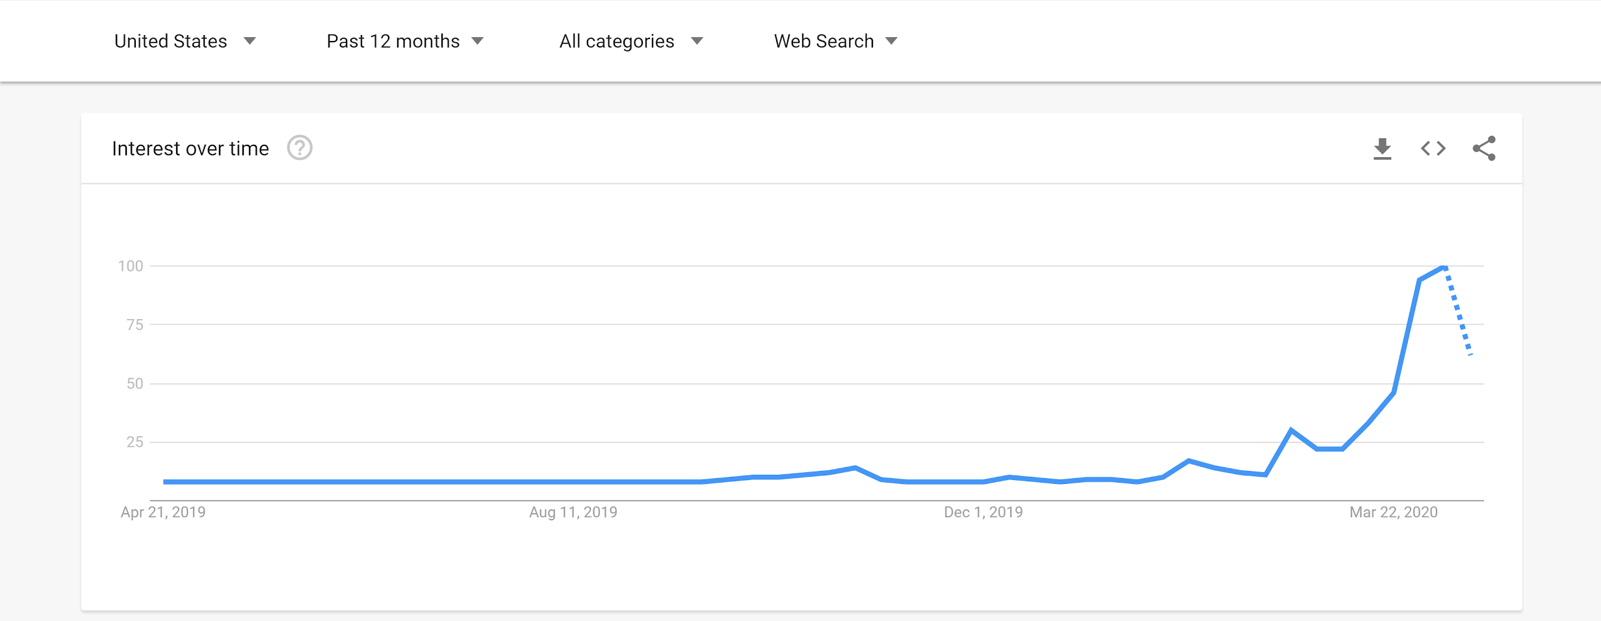
Recommendations:
Faster Reactions from the Government
Search Interest in Masks Over Time
April 13, 2020, CDC: Use cloth face coverings to slow the spread of COVID-19
Jan 20, 2020: First case confirmed by CDC
Jan 30, 2020, Trump: Coronavirus will have ‘a very good ending for us’
Notes:
So, what is our takeaway from this? When the first case of COVID-19 was found in US, search volume of “mask” increased a bit. When President Trump assured that the situation was within control, people’s interest in mask dropped. However, with the surging number of confirmed cases, the search volume surged as well and reached its peak when CDC suggested people use cloth face coverings. The plot shows that government guidelines play an important role in raising people’s awareness of wearing masks in public. We would recommend that state governments advise (if not require) all citizens to wear masks in public locations, as it really helps restrain the spread of infections.

Slide 11



Limitations
Real-world constraint from testing capacity
Limitation in Google Trends as a proxy
Aggregation on state-level
Notes:
Although we had some significant results and recommendations to take away, we did have some limitations in our analysis. Firstly, tracking on the number of cases of COVID-19 highly relies on testing capacity. Some states have limited testing kits, and that would undermine the number of confirmed cases entering the record.
Secondly, in using Google Trends as a proxy for how people are interested in and actively using masks, we face the limitation that searching for masks isn’t always equal to actually wearing masks. Hence, our model only measured the effect of the ‘awareness’, but not the actual usage of masks. (In addition, we cannot tell how many searches there are supposed to be corresponding to 1 unit of search interest, because the search interest index was standardized by google before publishing.)
Finally, our data is aggregated on a state-level, which is a relatively high level of aggregation. We could improve our model if we have all detailed records on county levels.

Slide 12

Thank You!
Stay safe, healthy and happy :-)
Notes:
That will conclude our analysis. I hope you enjoyed it. Thank you very much for listening. Stay safe, healthy, and happy!

